Slide 1
Special Relativity
Physics 102: Lecture 28
  Make sure your grade book entries are correct
Notes:
1

Slide 2
Inertial Reference Frame
Frame in which Newton’s Laws Work
uniform motion (constant velocity)
  No Accelerating
  No Rotating
Technically Earth is not inertial, but it’s close enough.
7
Notes:
Small distance gives quantum mechanics. High speed gives relativity

Slide 3
Postulates of Relativity
Laws of physics are the same in every inertial frame
  Perform experiment on a moving train and you should get same results as on a train at rest
Speed of light in vacuum is c for everyone
  Measure c=3x10⁸ m/s if you are on train going east or on train going west, even if light source isn’t on the train.
Weird!
9
Notes:
On train….can’t tell you are moving.
Toss ball back and forth; do collision experiments; etc.
Note that constancy of c is not really a separate postulate. Follows from EM theory.

Slide 4

Relative Velocity (Ball)
Example
Josh Beckett throws baseball @90 mph. How fast do I think it goes when I am:
  Standing still?
  Running 15 mph towards?
  Running 15 mph away?
90 mph
90+15=115 mph
90-15=75 mph
(Review Lecture 14 for help with Relative Velocities)
12

Slide 5
Relative Velocity (Light)
Example
Now he throws a photon (c=3x10⁸ m/s). How fast do I think it goes when I am:
  Standing still
  Running 1.5x10⁸ m/s towards
  Running 1.5x10⁸ m/s away
3x10⁸ m/s
3x10⁸ m/s
3x10⁸ m/s
Strange but True!
Preflight 28.1
15

Slide 6
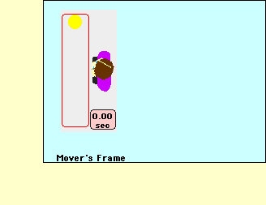

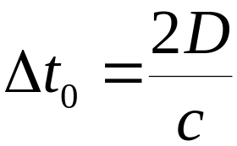
Consequences: 1. Time Dilation
D
t₀ is call the “proper time”, which is time between two events that occur at the same place.
21

Slide 7
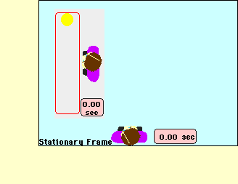
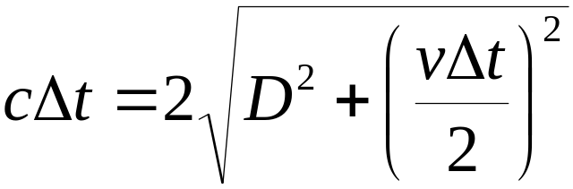
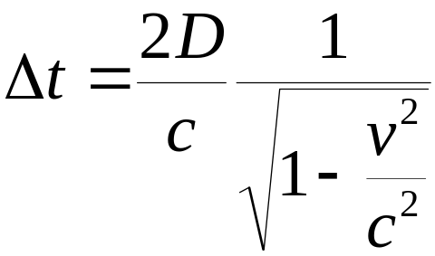
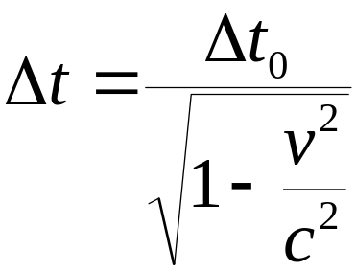
Time Dilation
L=v Δt
D
D
½ vΔt
t₀ is proper time
Because it is rest frame of event
23

Slide 8
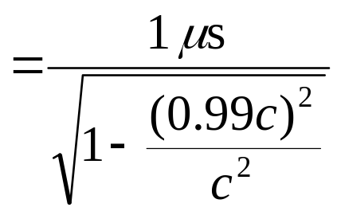
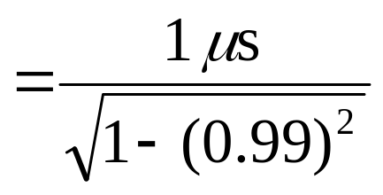
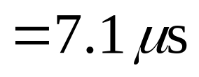
Time Dilation
Example
A π⁺ (pion) is an unstable elementary particle. It decays into other particles in 1 x 10⁻⁶ sec.
Suppose a π+ is created at Fermilab with a velocity v=0.99c. How long will it live before it decays?
If you are moving with the pion, it lives 1 μs
In lab frame where it has v=0.99c, it lives 7.1 times longer
Both are right!
This is not just “theory.” It has been verified experimentally (many times!)
27
Notes:
If you are riding along with pion, you will see it decay in 1 us. In that frame, birth and death occur at same point and the time interval between them is the proper time

Slide 9
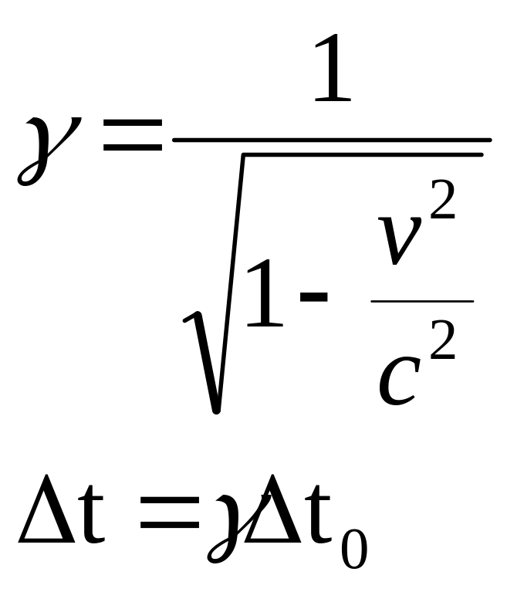
Time Dilation
Example
v/c | γ
0.1 | 1.005
0.2 | 1.021
0.5 | 1.155
0.9 | 2.294
0.99 | 7.089
0.999 | 22.366
0.9999 | 70.712
0.99999 | 223.607
0.999999 | 707.107
0.9999999 | 2236.068
29

Slide 10
Consequences II: Length Contraction
How do you measure the length of something?
  If at rest, it is easy—just use a ruler (“proper length”)
  If moving with velocity v, a harder problem
  Here is one way to do it
v

Slide 11
Length Contraction
Set up a grid of clocks at regular intervals, all sychronized
Observer A records time when front of train passes
All other observers record time when back of train passes
Find Observer B who records same time as A
Distance between A and B is the length of the train L measured in the frame in which the train is moving
Question: how does L compare with L₀, the proper length?
v
B
A

Slide 12
L vs. L₀
Tell observer A to flash light when front passes: event 1
Tell observer B to flash light when back passes: event 2
Observer C halfway between A and B sees light flashes simultaneously: concludes events 1 and 2 are simultaneous
What about observer D, who is riding at the center of the train?
D sees light pulse from A first, then sees light pulse from B
  He concludes: event 1 occurs before event 2
L is larger than L₀!
v
D
B
C
A

Slide 13
event 1: light at front flashes
event 2: light at back flashes
D sees light pulse from A first, then sees light pulse from B
He concludes: event 1 occurs before event 2
In words: front of train passes A before back of train passes B
Therefore, train is longer than distance between A and B
That is, L₀>L
In the frame in which the train is moving, the length is “contracted” (smaller)
D
B
A
Event 1
B
A
Event 2

Slide 14
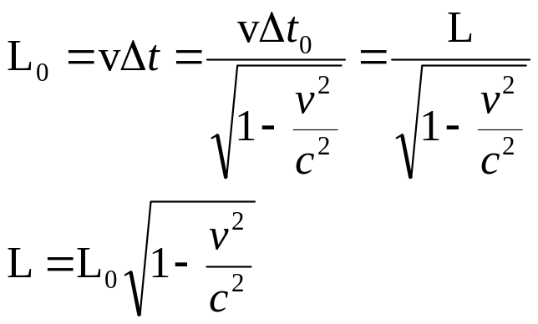
Another way to measure L
A starts timer when front of train passes
A stops timer when rear of train passes
L=vΔt₀
  This is a “proper time”: occurs at same place
Observer on train measures L₀=vΔt

Slide 15
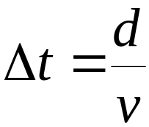
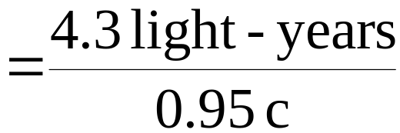

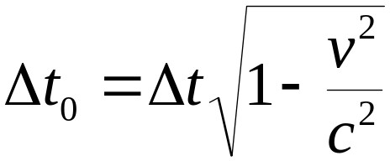

Space Travel
Example
Alpha Centauri is 4.3 light-years from earth. (It takes light 4.3 years to travel from earth to Alpha Centauri). How long would people on earth think it takes for a spaceship traveling v=0.95c to reach A.C.?
How long do people on the ship think it takes?
People on ship have ‘proper’ time they see earth leave, and Alpha Centauri arrive. Δt₀
Δt₀ = 1.4 years
33

Slide 16
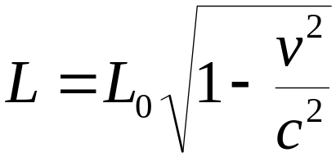
Length Contraction
Example
People on ship and on earth agree on relative velocity v = 0.95 c. But they disagree on the time (4.5 vs 1.4 years). What about the distance between the planets?
Earth/Alpha L₀ = v t
= .95 (3x10⁸ m/s) (4.5 years)
= 4x10¹⁶m (4.3 light years)
Ship L = v t
= .95 (3x10⁸ m/s) (1.4 years)
= 1.25x10¹⁶m (1.3 light years)
Length in moving frame
Length in object’s rest frame
38

Slide 17

Length Contraction Gifs
v=0.1 c
v=0.8 c
v=0.95 c
39

Slide 18




Length Contraction
Example
Sue is carrying a pole 10 meters long. Paul is on a barn which is 8 meters long. If Sue runs quickly v=.8 c, can she ever have the entire pole in the barn?
Paul: Sure the barn is 8 meters long, and the pole is only
Sue: No way! This pole is 10 meters long and that barn is only
Who is right?
A) Paul B) Sue C) Both
43

Slide 19
Preflight 28.3
You’re eating a burger at the interstellar café in outer space - your spaceship is parked outside. A speeder zooms by in an identical ship at half the speed of light. From your perspective, their ship looks:
(1) longer than your ship
(2) shorter than your ship
(3) exactly the same as your ship
In the speeder’s reference frame
L_{o} > L
In your reference frame
Always <1
44

Slide 20
Comparison:
Time Dilation vs. Length Contraction
Δt_{o} = time in reference frame in which two events occur at same place “proper time”
  i.e. if event is clock ticking, then Δt_{o} is in the reference frame of the clock (even if the clock is in a moving spaceship).
L_{o} = length in rest reference frame as object “proper length”
  length of the object when you don’t think it’s moving.
Time seems longer
from “outside”
Δt > Δt_{o}
Length seems shorter
from “outside”
L_{o} > L
46

Slide 21
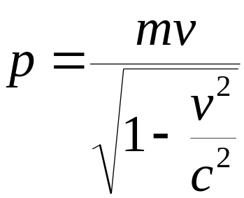
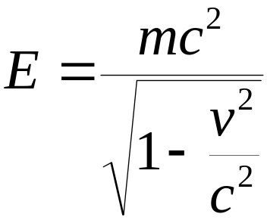
Relativistic Momentum
Relativistic Momentum
Note: for v<<c p=mv
Note: for v=c p=infinity
Relativistic Energy
Note: for v=0 E = mc²
Note: for v<<c E = mc² + ½ mv²
Note: for v=c E = infinity (if m is not 0)
Objects with mass always have v<c!
48

Slide 22
Summary
Physics works in any inertial frame
  Simultaneous depends on frame
    Proper frame is where event is at same place, or object is not moving.
  Time dilates relative to proper time
  Length contracts relative to proper length
  Energy/Momentum conserved
For v<<c reduce to Newton’s Laws
50

